Slide 1
Section 14.3
Probability
Copyright © 2012 Pearson Education, Inc. Publishing as Prentice Hall.

Slide 2


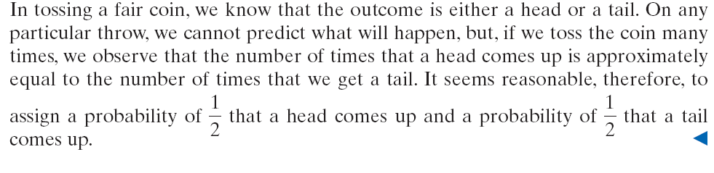
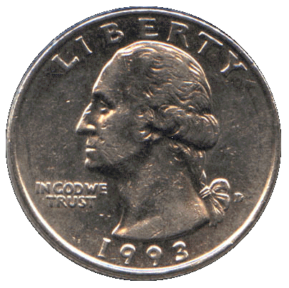
Copyright © 2012 Pearson Education, Inc. Publishing as Prentice Hall.

Slide 3

Copyright © 2012 Pearson Education, Inc. Publishing as Prentice Hall.

Slide 4
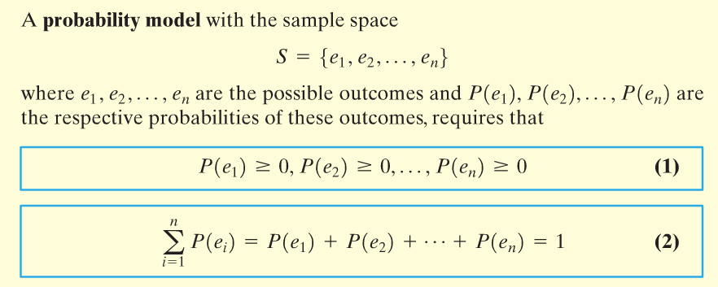
Copyright © 2012 Pearson Education, Inc. Publishing as Prentice Hall.

Slide 5
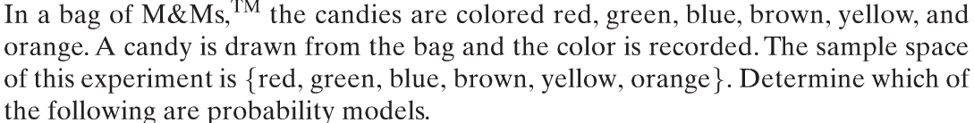
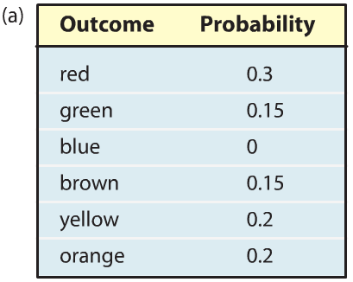
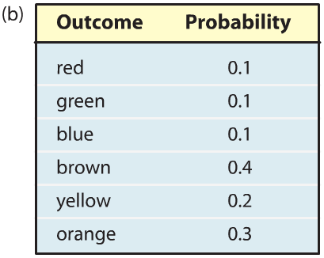
Copyright © 2012 Pearson Education, Inc. Publishing as Prentice Hall.

Slide 6
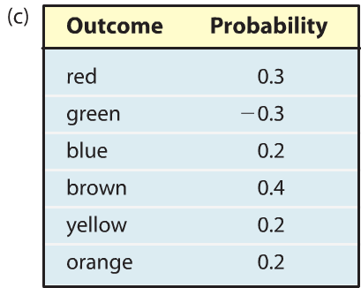
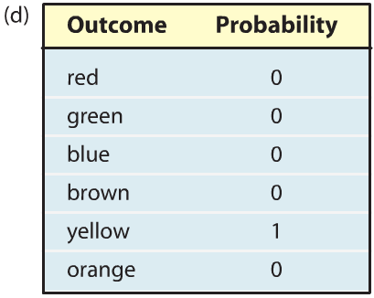
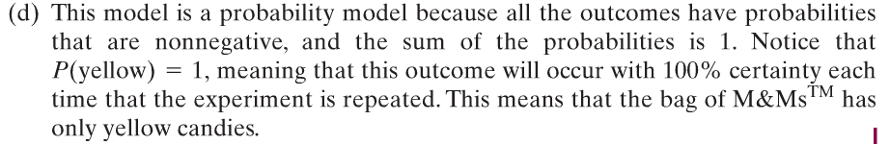
Copyright © 2012 Pearson Education, Inc. Publishing as Prentice Hall.

Slide 7
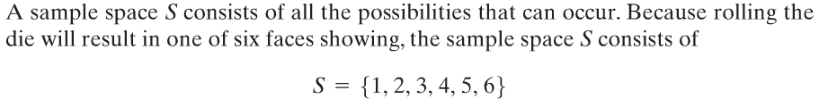
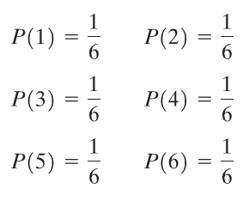
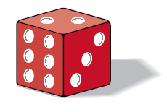
Copyright © 2012 Pearson Education, Inc. Publishing as Prentice Hall.

Slide 8
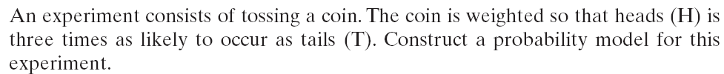
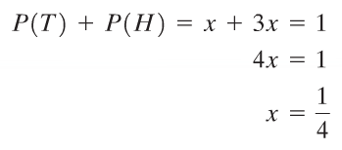

Copyright © 2012 Pearson Education, Inc. Publishing as Prentice Hall.

Slide 9
Copyright © 2012 Pearson Education, Inc. Publishing as Prentice Hall.

Slide 10

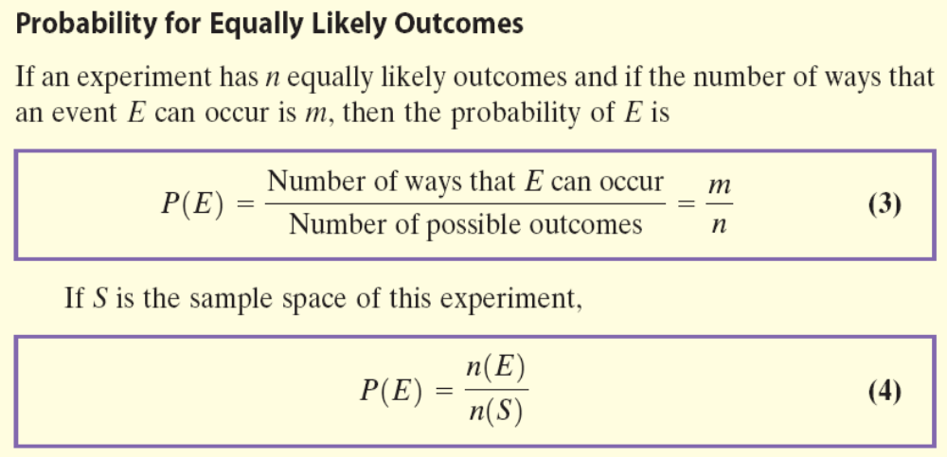
Copyright © 2012 Pearson Education, Inc. Publishing as Prentice Hall.

Slide 11
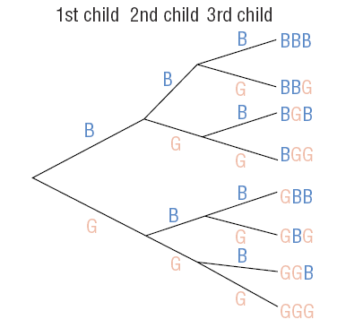



Copyright © 2012 Pearson Education, Inc. Publishing as Prentice Hall.

Slide 12
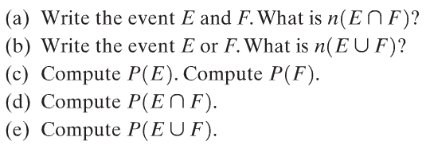
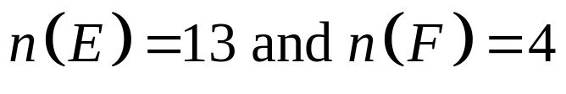
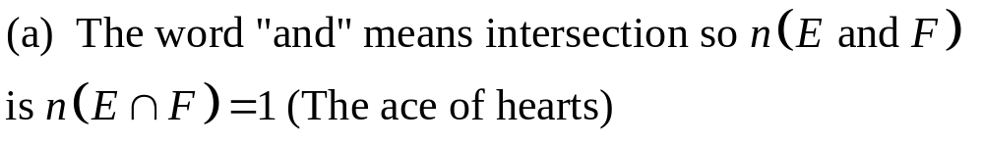
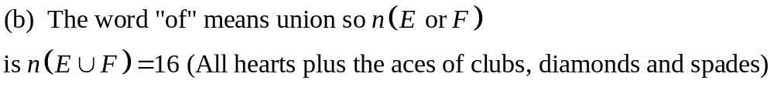
Consider the experiment of drawing a card from a standard 52 card deck of playing cards (ace through king, four suits). Let E represent the event “draw a heart” and let F represent the event “draw an ace”.
Copyright © 2012 Pearson Education, Inc. Publishing as Prentice Hall.

Slide 13


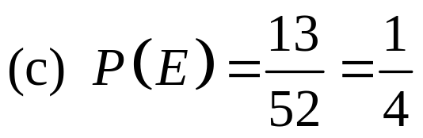
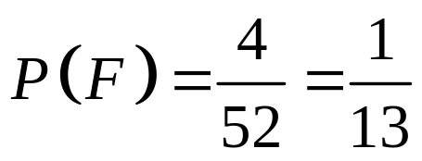
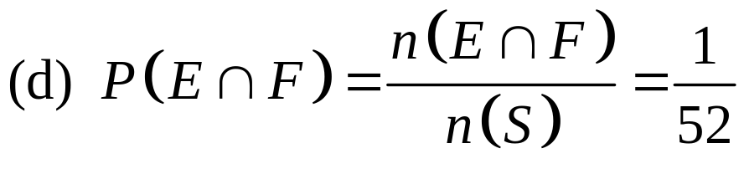
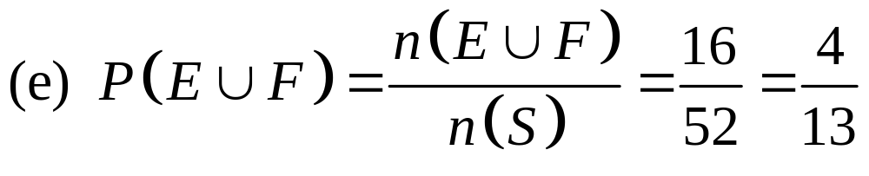
Consider the experiment of drawing a card from a standard 52 card deck of playing cards (ace through king, four suits). Let E represent the event “draw a heart” and let F represent the event “draw an ace”.
Copyright © 2012 Pearson Education, Inc. Publishing as Prentice Hall.

Slide 14
Copyright © 2012 Pearson Education, Inc. Publishing as Prentice Hall.

Slide 15
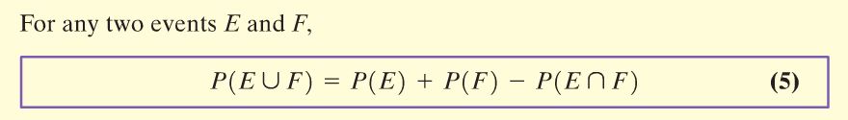
Copyright © 2012 Pearson Education, Inc. Publishing as Prentice Hall.

Slide 16

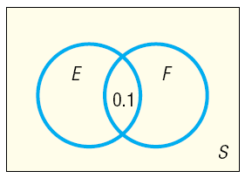
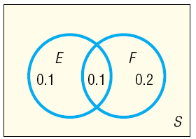
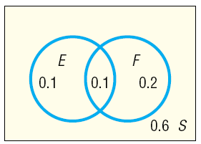
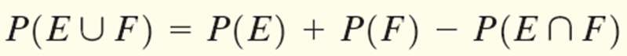
Copyright © 2012 Pearson Education, Inc. Publishing as Prentice Hall.

Slide 17
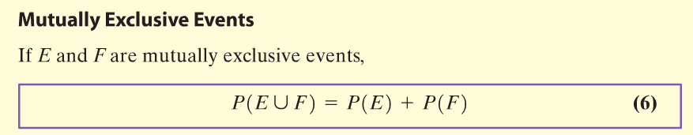
Copyright © 2012 Pearson Education, Inc. Publishing as Prentice Hall.

Slide 18
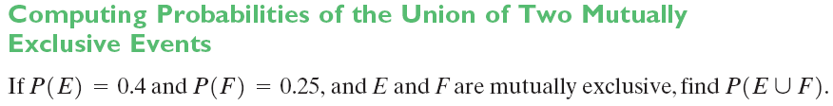
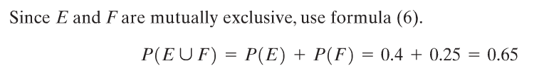
Copyright © 2012 Pearson Education, Inc. Publishing as Prentice Hall.

Slide 19
Copyright © 2012 Pearson Education, Inc. Publishing as Prentice Hall.

Slide 20
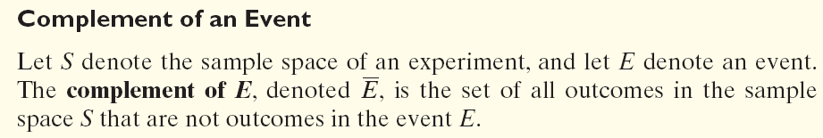
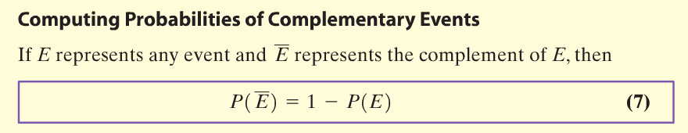
Copyright © 2012 Pearson Education, Inc. Publishing as Prentice Hall.

Slide 21
On the local news the weather reporter stated that the probability of rain tomorrow is 30%. What is the probability that it will not rain?
Copyright © 2012 Pearson Education, Inc. Publishing as Prentice Hall.

Slide 22


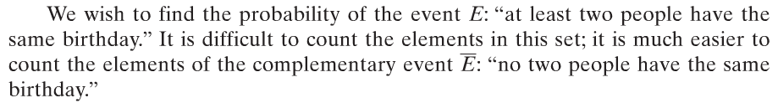

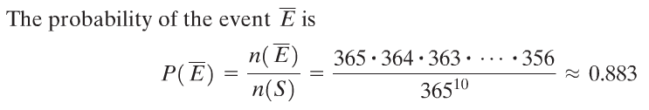
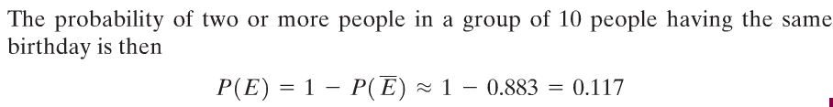
What is the probability that in a group of 10 people at least 2 people have the same birthday? Assume that there are 365 days in a year.
Copyright © 2012 Pearson Education, Inc. Publishing as Prentice Hall.

Slide 23
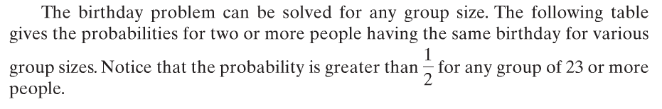

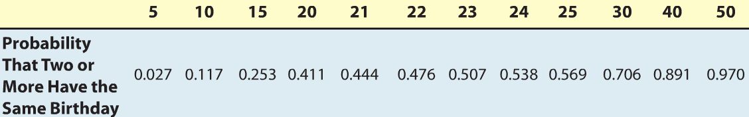
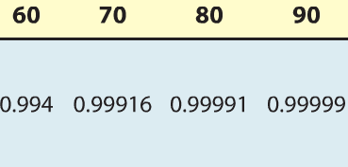
Copyright © 2012 Pearson Education, Inc. Publishing as Prentice Hall.

